Slide 1

TITLE: Prediction of duration of stay for a specific disease Project Category: RESEARCH
Designation : Assistant Professor
Department: Networking and Communication
Guide Name :Mr. Karthikeyan .H Student names:
YASHI JAIN (RA2111031010058)
YASH KUMAR (RA2111031010056)
ARYAMAN SINGH (RA2111029010041)

Slide 2
ZEROTH REVIEW
Prediction of length of stay of disease

Slide 3
Abstract
This study aimed to assess the performance improvement for machine learning-based hospital length of stay (LOS) predictions when clinical signs written in text are accounted for and compared to the traditional approach of solely considering structured information such as age, gender and major symptoms . We will use machine learning models like supervised learning for classification of disease based on patients data, We will use machine learning algorithms specifically like support vector machine(SVM), Random Forest algorithms. Models were trained on 80% of data and performance was evaluated by accuracy on the remaining 20% test data.
In Supervised Learning algorithms learn to map points between inputs and correct outputs. It has both training and validation datasets labelled. We will be focusing on lung diseases mainly. We will use software like Tableau for data visualization.

Slide 4
Introduction
For customers who prefer an on-premise solution, the implementation with Microsoft Machine Learning Services is a great option that takes advantage of the powerful combination of SQL Server and the Python language. We have modeled the steps in the template after a realistic team collaboration on a data science process. Data scientists do the data preparation, model training, and evaluation from their favorite IDE. DBAs can take care of the deployment using SQL stored procedures with embedded code. Power BI is also available for analysts to visualize the deployed results. We also show how each of these steps can be executed on a SQL Server client environment such as SQL Server Management Studio . Length of stay (LOS) is a critical indicator for hospital management and has direct consequences on hospital costs and patient satisfaction. Moreover, LOS is correlated with disease severity and mortality . When a patient is in the emergency department (ED), some predictors of hospital LOS are known before hospital admission. Studies have found patients at an ED are associated with a longer LOS and patients who develop further complications in intensive care units (ICU) have a longer LOS beforehand at the ED . For stroke patients, however, there is a significant inverse linear association between LOS at the ED and hospital LOS . ED crowding and hospital occupancy at entry are predicted to have longer LOS , however, there are other hospital characteristics that play a role in determining it.

Slide 5
Patient characteristics also influence LOS, such as demographic characteristics and comorbidities which are often available at admission . Depending on the medical specialty, physicians can predict LOS although they tend to underestimate LOS in some cases such as patients with heart failure with LOS > 3 days .
This solution starts with data stored in SQL Server. The data scientist works from the convenience of an IDE on her client machine, while setting the data context to SQL. When she is done, her code is operationalized as stored procedures in the SQL Database. Finally, the data, along with the predicted LOS are then visualized with Tableau.
We will use supervised algorithm to identify different diseases according to the patient data and history. Supervised learning is defined as when a model gets trained on a “Labelled Dataset”. Labelled datasets have both input and output parameters. In Supervised Learning algorithms learn to map points between inputs and correct outputs. It has both training and validation datasets labelled.

Slide 6
Problem Statement
Every time we go to a doctor and if we aren’t well we are scared that the doctor will tell us to stay in hospital for a few days. We do not know how many Number of days we have to stay . This is a challenge faced by many people across the world of different age groups . This problem leads them not to go to doctor because of the fear and resulting in falling more sick or not handling your sickness with care.
Therefore , we will develop a machine learning model to estimate the length of stay for a particular disease which would be an ease to people as well as to the hospital because they would already know the number of days a person will stay so it would be easier for them to inform other patients in case if the room is already booked.

Slide 7
We are mainly focusing on lung diseases like,
Lung disease is any problem in the lungs that prevents the lungs from working properly. There are three main types of lung disease:
Airway diseases -- These diseases affect the tubes (airways) that carry oxygen and other gases into and out of the lungs. They usually cause a narrowing or blockage of the airways. Airway diseases include asthma, chronic obstructive pulmonary disease (COPD), bronchiolitis, and bronchiectasis (which also is the main disorder for persons with cystic fibrosis). People with airway diseases often say they feel as if they're "trying to breathe out through a straw.“
Lung tissue diseases -- These diseases affect the structure of the lung tissue. Scarring or inflammation of the tissue makes the lungs unable to expand fully (restrictive lung disease). This makes it hard for the lungs to take in oxygen and release carbon dioxide. People with this type of lung disorder often say they feel as if they are "wearing a too-tight sweater or vest." As a result, they can't breathe deeply. Pulmonary fibrosis and sarcoidosis are examples of lung tissue disease.
Lung circulation diseases -- These diseases affect the blood vessels in the lungs. They are caused by clotting, scarring, or inflammation of the blood vessels. They affect the ability of the lungs to take up oxygen and release carbon dioxide. These diseases may also affect heart function. An example of a lung circulation disease is pulmonary hypertension. People with these conditions often feel very short of breath when they exert themselves.

Slide 8
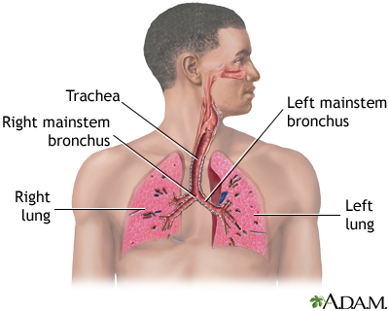
The most common lung diseases include:
Asthma
Collapse of part or all of the lung (pneumothorax or atelectasis)
Swelling and inflammation in the main passages (bronchial tubes) that carry air to the lungs (bronchitis)
COPD
Lung cancer
Lung infection (pneumonia)
Abnormal buildup of fluid in the lungs (pulmonary edema)
Blocked lung artery (pulmonary embolus)

Slide 9
Additional Features
To improve model performance, feature are added, like a patient can know about what diseases he may go through or be affected at his age, knowledge about his disease or any other disease.
Personal information of patients and the context were kept for both featured sets. In the first set, the structured diagnosis information was added, whereas in the second set, only the clinical data directly extracted from the text notes was added.
To produce a fair comparison, the following three sets of features were chosen:
features common to both sets including,
age, gender, zip/postal code
It also has a feature will show you the risks of diseases one can suffer at that ag e. This will be done by using Support Vector Machines(SVM) and KNN nearest algorithms.

Slide 10
Conclusion
This study shows that data can be used to predict LOS with acceptable predictive performance. The performance was similar to the performance of the model using structured data. Structured data, however, may have the drawback of being more time-consuming to extract . As the methods to automatically extract knowledge evolve, they will undoubtedly give more accurate predictions.
Future research needs to determine how these methods can ultimately improve healthcare outcomes while complying with privacy laws and maintaining high ethical standards.

Slide 11
First Review
Table of contents
Objectives of length of stay of disease
Daily scrums
System Architecture(High Level Design)
ER Diagram
Sprint Retrospective Document
Result Analysis

Slide 12
Objectives of length of stay of disease
1. To Ease Human life
Major objective of Calculating length of stay of disease is to make people’s life easier than it was. Any person does not need to go to a doctor, our research impacts on making their life easier by stating the duration of staying in hospital. This can be done by the following :
Epic 1: Data Collection and Preparation
Objective: Gather, clean, and validate patient data related to lung disease, including demographic, clinical, and treatment information.
Epic 2: Data Analysis
Objective: Analyze the collected data to identify key factors influencing the length of stay for lung disease patients.

Slide 13
2. Cost Efficient
There is no need to spend money by going to a doctor as our device can tell you about the disease with additional information stating the condition of your lungs without any need of consulting a doctor.
3. Improving patient care
LOS can help identify areas for improvement in patient management and treatment processes.
4. Benchmarking
LOS can be used to compare the performance of different hospitals and health systems.
5. Reducing costs
Shorter LOS can reduce the cost per discharge and free up hospital beds.
6. Reducing risk
Shorter LOS can reduce the risk of hospital-acquired infections (HAIs) and medication side effects.
7.Improving outcomes
Shorter LOS can improve treatment outcomes and lower mortality rates.

Slide 14
Daily Scrums for length of stay of Disesase
Key Elements of a Lung Disease Focused Daily Scrum:
1. Patient Review :
- Current Status : Quickly review each lung disease patient’s condition, treatments, and any changes since the last meeting. - - Length of Stay Goals : Discuss the target discharge date and compare it with the current expected LOS. Highlight any deviations.
2. Identification of Barriers:
Clinical Barriers :Are there unresolved medical issues such as ongoing oxygen dependency, unresolved infections, or breadthe control
Non-Clinical Barriers : Consider discharge planning challenges, such as home care arrangements, patient education needs, or delays in diagnostic testing.
3. Action Items:
- Immediate Next Steps : What needs to be done today to move the patient closer to discharge? This could involve adjusting treatment plans, ordering necessary tests, or arranging consultations with specialists.
- Resource Allocation : Identify any additional resources needed, such as respiratory therapy, physiotherapy, or social work support, to expedite discharge.

Slide 15
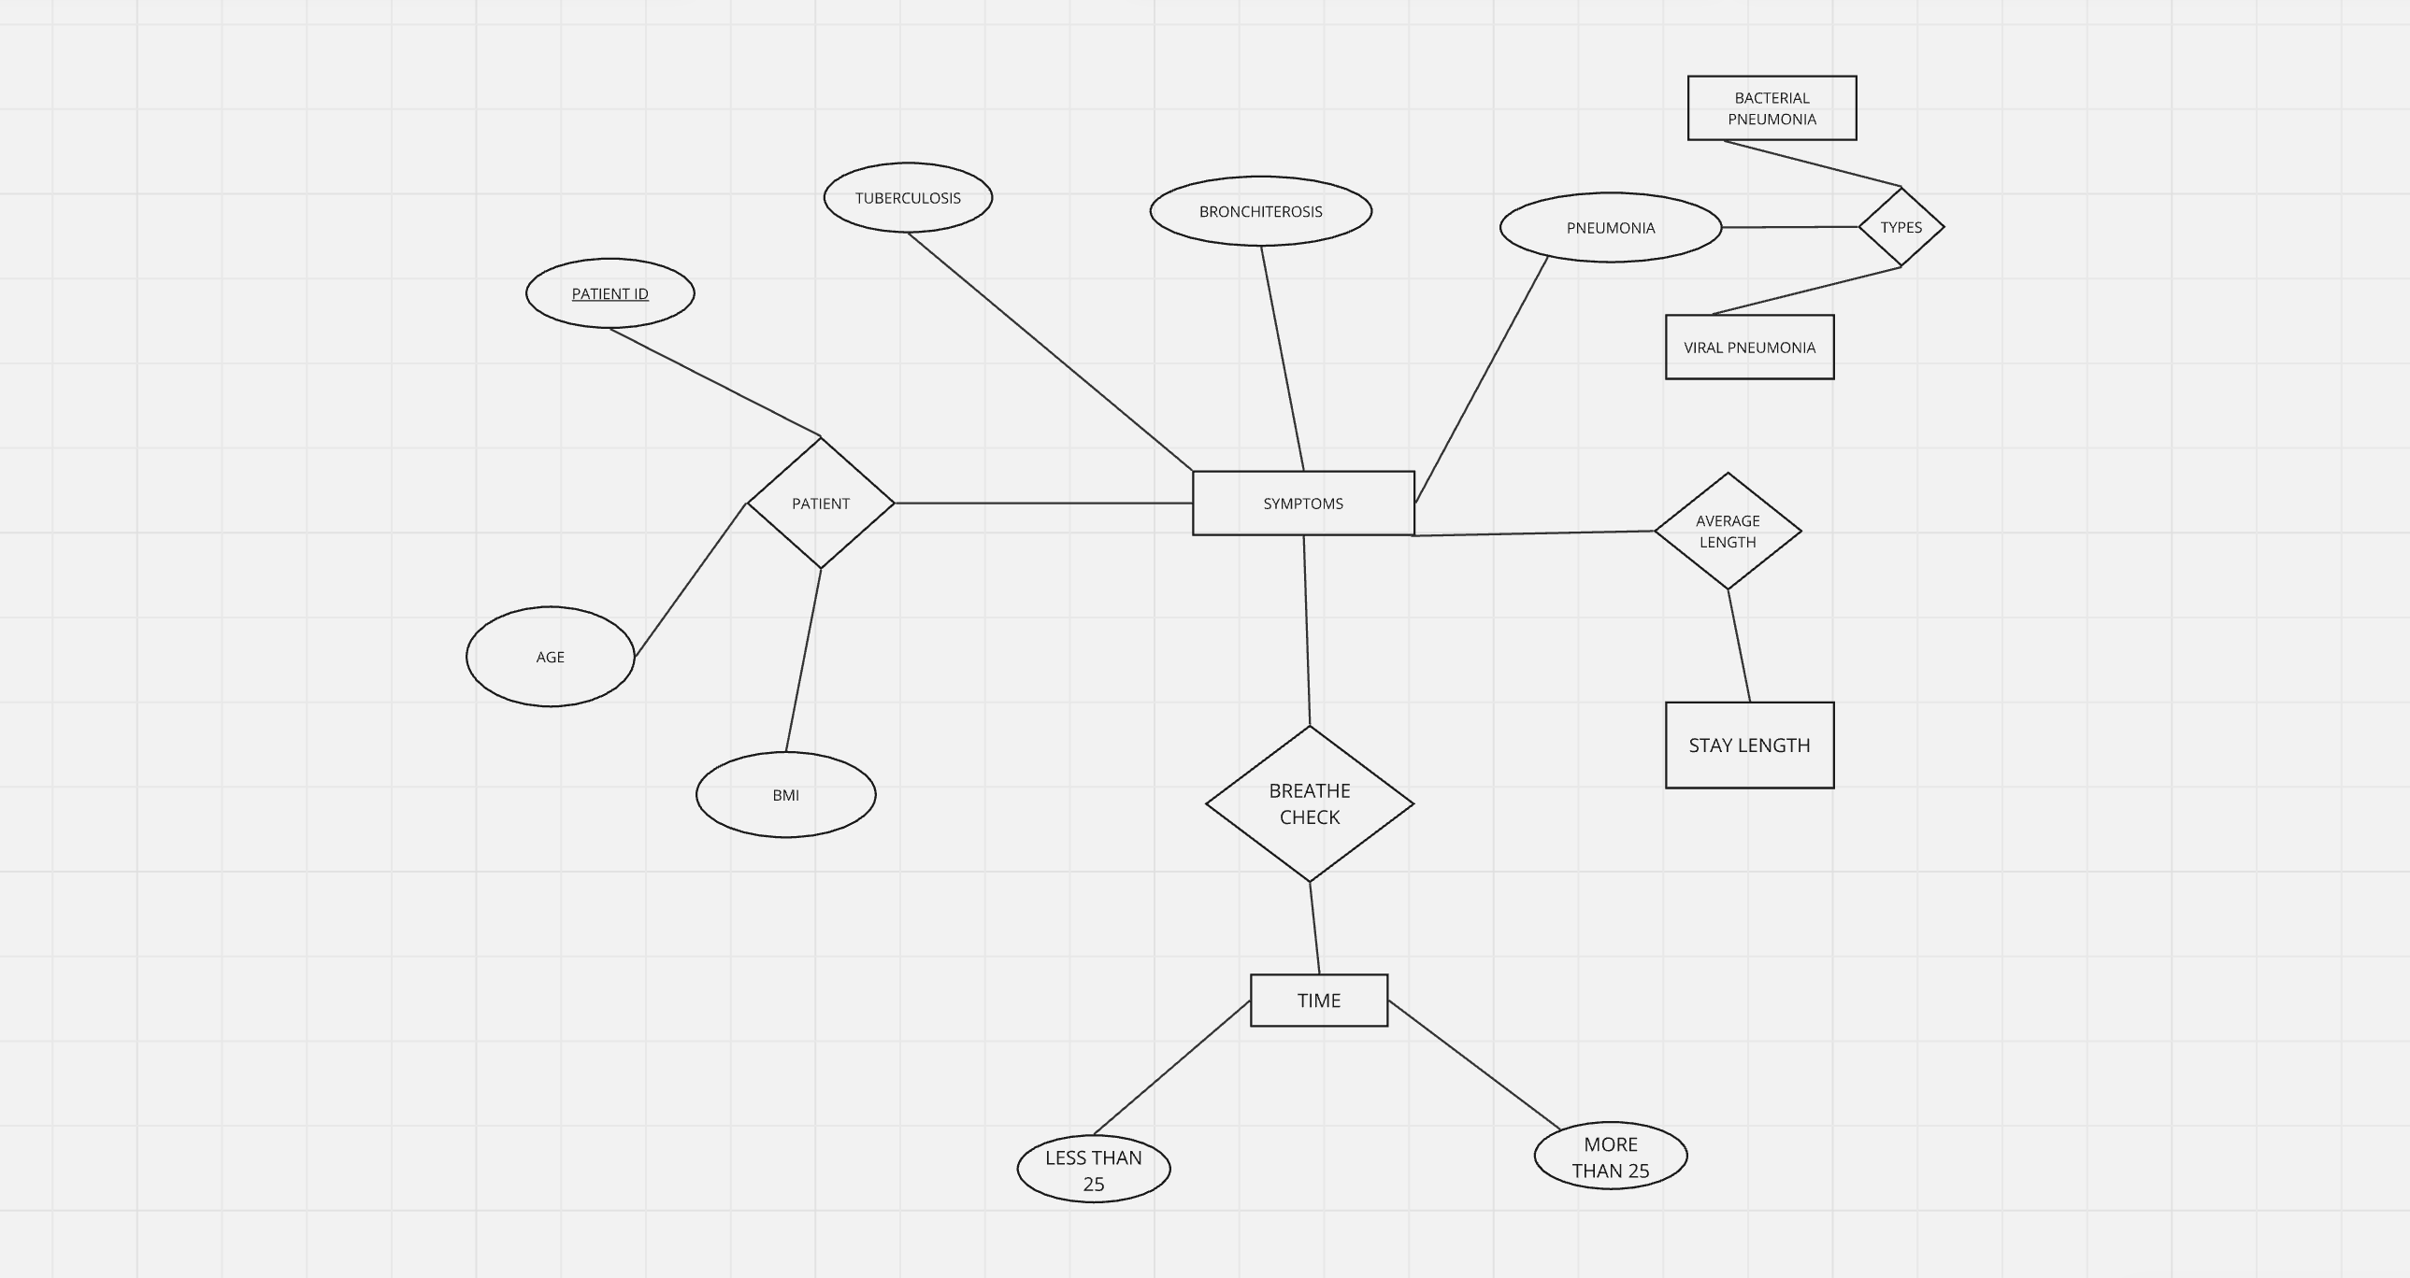
ER DIAGRAM

Slide 16
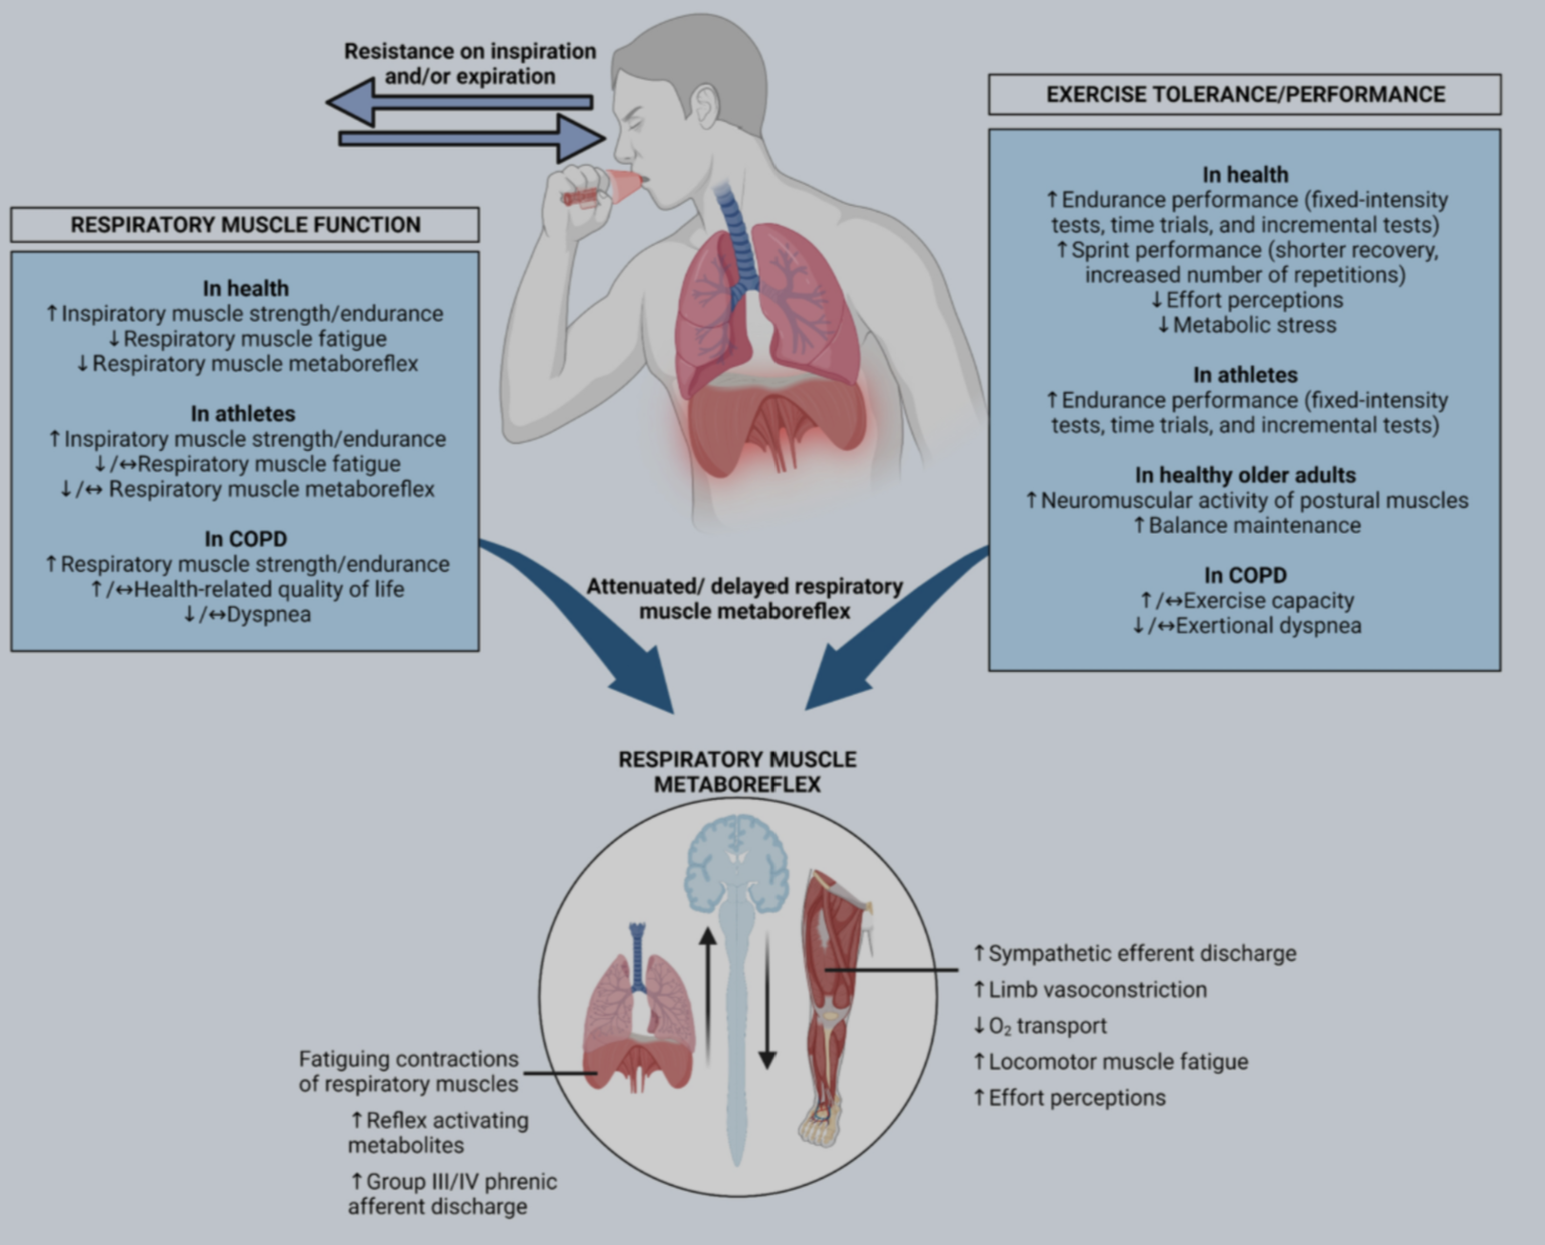
Sprint Retrospective Document

Slide 17
Result Analysis
Data Analysis :
Average LOS: The mean length of stay for lung disease patients was [X] days.
Significant Factors: Age, presence of chronic comorbidities (such as COPD and heart disease), and treatment types (invasive vs. non-invasive) were the most significant factors affecting LOS.
Demographics: Older patients and those with multiple comorbidities had a longer LOS on average.
2. Predictive Modeling :
Model Performance: The predictive model achieved an accuracy of 85%, with predictions deviating by an average of 1.5 days from actual LOS.
Feature Importance: Age and comorbidities were the top predictors of LOS, followed by the type of treatment received.
3. Operational Impact :
Resource Allocation: The insights from the analysis led to improved resource allocation, with a focus on early discharge planning for patients at lower risk.

Slide 18
Second Review
Proposed Methodology
Aim:
This paper aims to investigate the classification performance of MRI images for prediction of length of stay of disease through CNN. The research uses CNN as the backbone of the model along with transfer learning and addition of custom CNN layers. The CNN model with additional convolutional layers is used for feature extraction. The hybrid architecture is designed to classify MRI brain scans into four categories: Unhealthy , Healthy Lung and then predict the length of stay of disease.

Slide 19
Dataset:
A curated set of MRI scans has been used to test and train the model and evaluate the performance of the algorithm. MRI data provide details of the lung and visualize the anatomy in all planes. This study uses a publicly available dataset acquired from Kaggle, comprising 4 classes namely mild, very mild, moderate, and non-demented. The dataset comprises 30,000+ images of size 200 x 190 pixels which are used for training and testing in the ratio 8:2.
In our experiments, multiple images from one patient are treated independently, as if for different patients.
Data Preprocessing steps:
Normalising pixel intensities.
Rescaling all images.
Adjusting rotation and zoom range
Training and Testing Split

Slide 20
Model Workflow:
The architecture of the proposed model for prediction of length of stay of disease is built upon a trained CNN model which serves as the backbone for feature extraction. The CNN model comprises five convolutional blocks, each consisting of convolutional layers followed by max pooling layers. The earlier layers focus on detecting simple patterns such as edges, while the deeper layers capture more complex structures related to Prediction progression. To enhance the model's capacity and identify domain-specific features, additional convolutional layers have been added to the CNN network. The output from these layers is then flattened into a one-dimensional feature vector. This hybrid architecture combines the representational power of deep learning with the classification capabilities of CNN, aims to improve the overall accuracy.
Input Layer
This is where the CNN starts. In your case, it’s like feeding the network an X-ray or CT scan of lungs. The image is broken down into a grid of numbers, where each number represents a pixel’s intensity (e.g., shades of gray in a medical scan). This is how the network “sees” the lung.
2. Convolution Layer (Detecting Lung Patterns)
Here, the CNN acts like a radiologist scanning the lung image. It uses filters to search for specific features or patterns—like the edges of the lungs, abnormal growths, or patterns that signify healthy tissue versus diseased tissue.This layer might detect critical features like lung shape irregularities, patches that could indicate diseases, or areas of excessive darkness/lightness.

Slide 21
3. ReLU Layer
If a filter detects something important, like a shadow in the lung that could indicate disease, this layer amplifies that detection. It removes any noise or irrelevant information (such as areas that don’t contribute to disease diagnosis) by setting weak signals to zero.
It makes sure that only strong indicators of disease or health are passed along to the next layer, ignoring any irrelevant patterns.
4. Pooling Layer
It reduces the complexity by shrinking the image while preserving the essential features. For instance, it might look at small patches of the lung and take the most important information (like an average or maximum feature value) from each. This layer could reduce the image's resolution while keeping critical features intact—like retaining information about a suspicious lesion but ignoring fine details that aren’t critical for diagnosis.
5. Fully Connected Layer
After simplifying and detecting features, the network uses a fully connected layer to decide how these features relate to the lung's overall health. This layer acts like a decision-maker, linking patterns detected (e.g., abnormal spots, irregularities) to potential diagnoses (healthy or unhealthy lungs). It essentially forms the "big picture" by connecting all the important pieces.This layer helps the CNN decide whether the patterns it found point toward a healthy lung or lung disease based on the training data it has learned from.

Slide 22
6. Output Layer
This is where the network delivers the result you’re interested in for your project: whether the lung is healthy or diseased. This is the layer where the CNN tells you the final classification of the lung image, whether it's healthy or unhealthy, based on all the patterns and features it has analyzed , prediction of length of stay of disease.

Slide 23
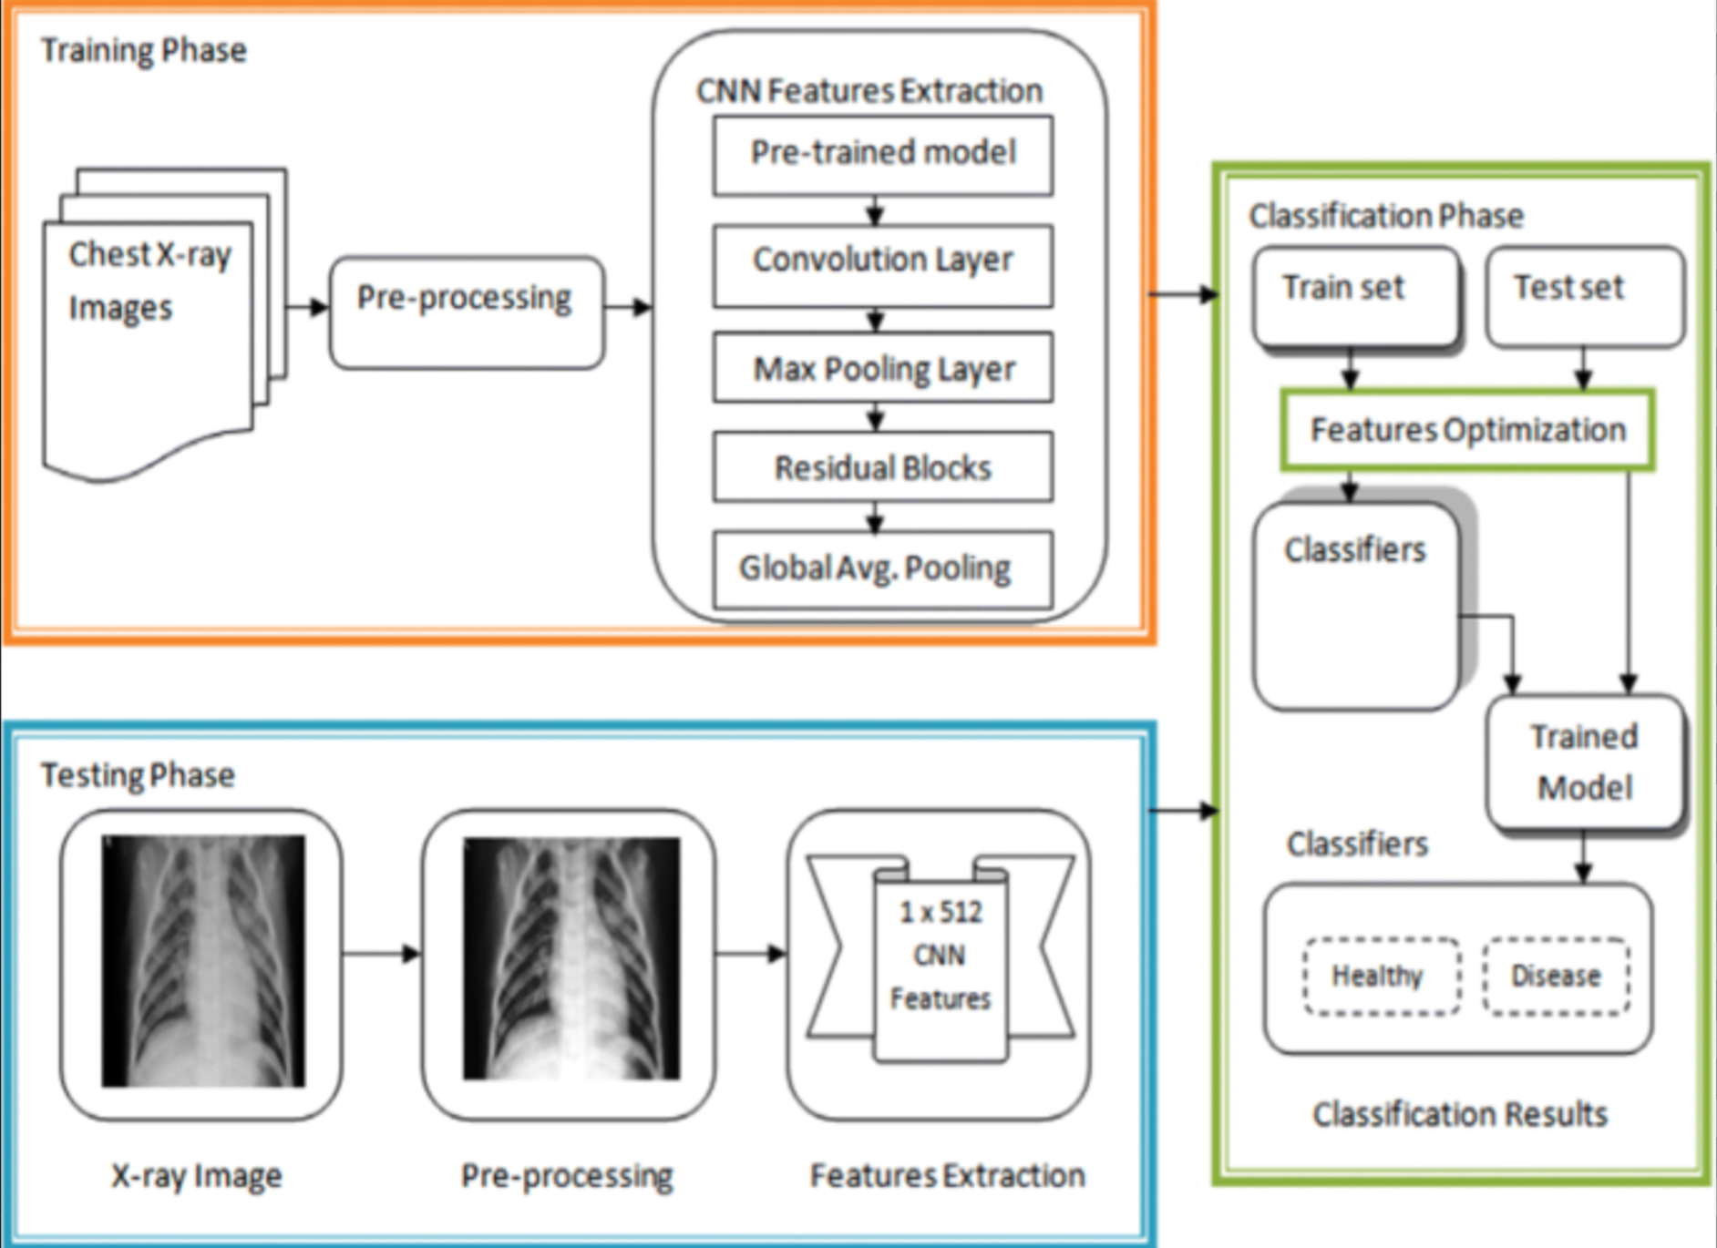
Architecture Document (High level diagram)

